Slide 1
Chapter 3
Introduction to Logic
Section 3-4
The Conditional and Related Statements

Slide 2
The Conditional and Related Statements - Objectives
Determine the converse, inverse, and contrapositive of a conditional statement.
Translate conditional statements into alternative forms.
Understand the structure of the biconditional.
Summarize the truth tables of compound statements.

Slide 3
Converse, Inverse, and Contrapositive ** NOTECARD !! **
Conditional Statement |  | If p, then q
Converse |  | If q, then p
Inverse | ~p → ~q | If not p, then not q
Contrapositive | ~q → ~p | If not q, then not p

Slide 4
Example: Determining Related Conditional Statements
Determine each of the following, given the conditional statement:
If I am running, then I am moving.
a) the converse b) the inverse c) the contrapositive
Solution
a) If I am moving, then I am running.
b) If I am not running, then I am not moving.
c) If I am not moving, then I am not running.

Slide 5
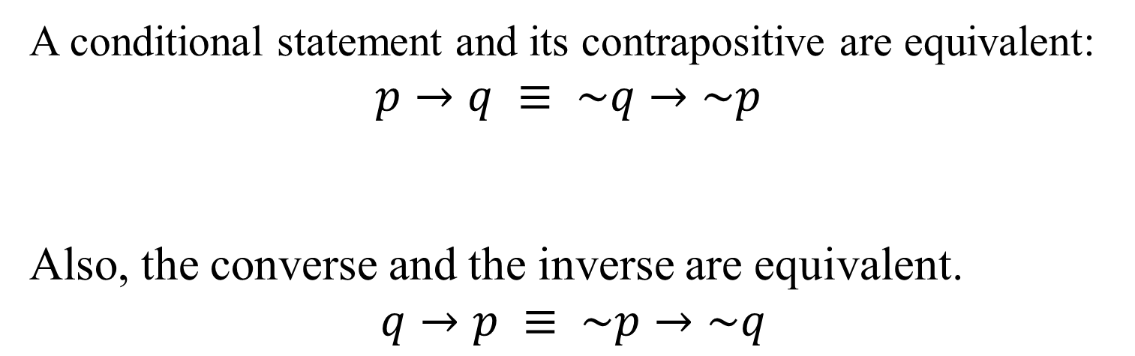
Equivalences
A conditional statement and its contrapositive are equivalent:
$$p→q ≡ \sim q→\sim p$$
Also, the converse and the inverse are equivalent.
$$q→p ≡ \sim p→\sim q$$

Slide 6
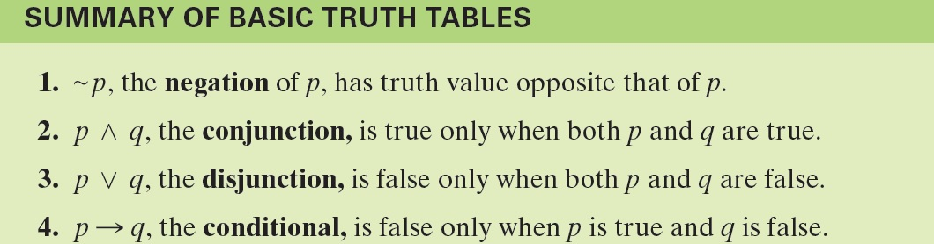
Summary of Truth Tables

